Slide 1
Final Engagement
Attack, Defense & Analysis of a Vulnerable Network

Slide 2
Table of Contents
This document contains the following resources:
Network Topology & Critical Vulnerabilities
Exploits Used
Methods Used to Avoiding Detect

Slide 3

Network Topology
& Critical Vulnerabilities
‹#›

Slide 4
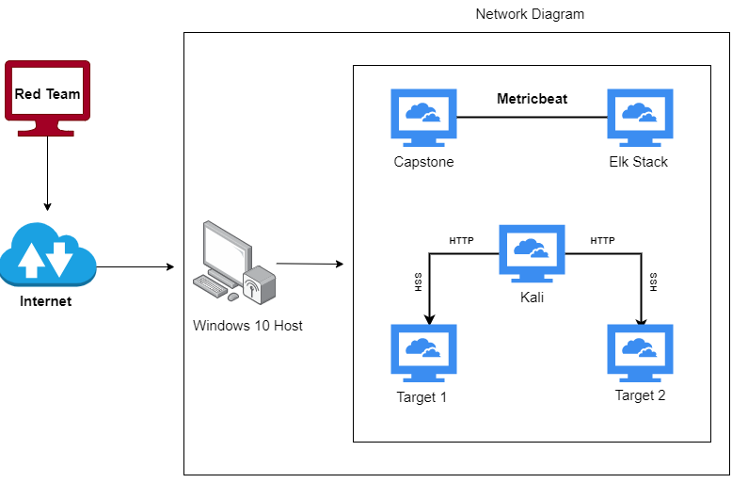
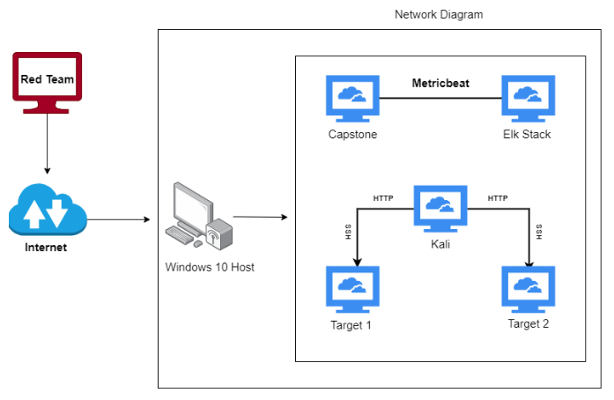
Network Topology
Network
Address Range: 192.168.1.0/24
Netmask:
Gateway: 192.168.1.1
Machines
IPv4: 192.168.1.110
OS: Debian
Hostname: target1
IPv4: 192.168.1.115
OS: Debian
Hostname: target2
IPv4: 192.168.1.100
OS:Ubuntu
Hostname: Kibana/Elasticsearch
IPv4: 192.168.1.105
OS:Ubuntu
Hostname: Capstone
IPv4: 192.168.1.90
OS:Debian
Hostname: Kali

Slide 5
Critical Vulnerabilities: Target 1
Our assessment uncovered the following critical vulnerabilities in Target 1.
Vulnerability | Description | Impact
User michael had weak password | Password was his User ID | Easily exploited login credentials to logon to the Wordpress server over SSH
Wordpress Config File had invalid permissions | wp-config.php was world readable and contained the DB login credentials | Attacker was able to read hashed passwords in the WORDPRESS database.
Weak password in Wordpress database | Ran John the Ripper against hashed passwords and cracked Steven’s | Access to the admin pages for the Wordpress server.
Server was vulnerable to wpscan | Provided user names | Provided user names

Slide 6
Exploits Used
‹#›

Slide 7
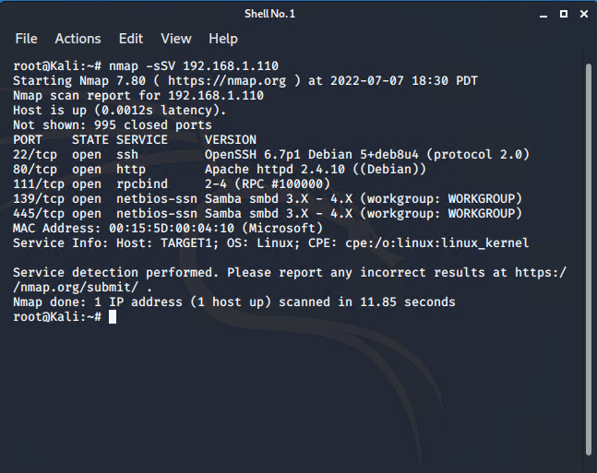
Exploitation: Port Scanning
Summarize the following:
We used nmap to determine open ports and services running on target 1.

Slide 8
Exploitation: Weak password for user michael
Summarize the following:
Weak password for user michael (password = login ID).
Was able to login as michael on the target system using ssh with cracked password.
No need for a screen shot.

Slide 9
Exploitation: Wordpress Config File had invalid permissions
Summarize the following:
Permissions for /var/www/html/wordpress/wp-config.php was set to 777, which allows all logged on users to read and update the file.
The information in the file provided Mysql database connection and authentication information.

Slide 10
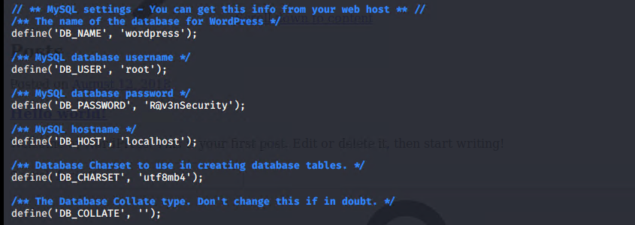
Contents of wp-config.php

Slide 11
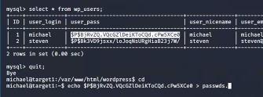
Exploitation: Weak passwords in the database users tables
Summarize the following:
Table users contained hashed passwords.
We used John the Ripper to crack the Wordpress password for Steven.

Slide 12
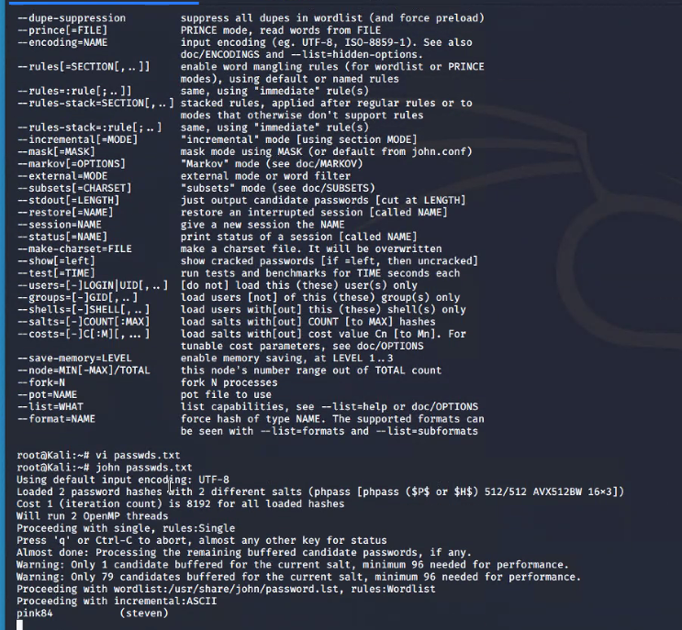
Exploitation: John the Ripper screenshot
Summarize the following:
Table users contained hashed passwords.
We used John the Ripper to crack the Wordpress password for Steven.

Slide 13
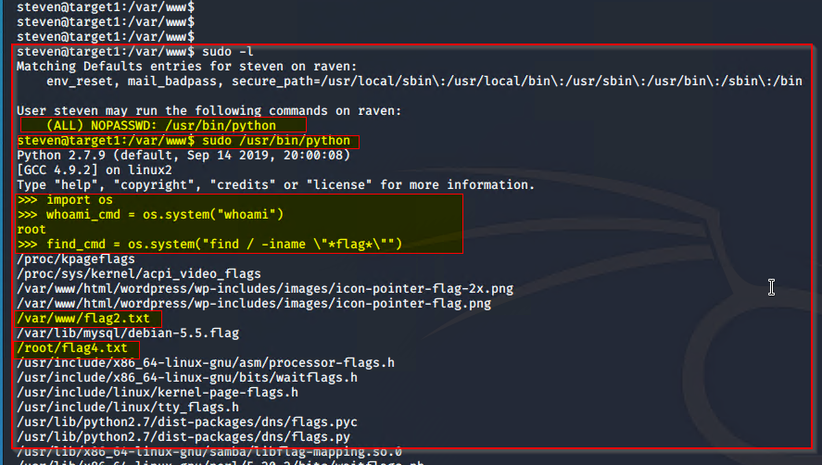
Exploitation: User Steven had Sudo privileges to run Python
Summarize the following:
User steven has sudo access to python and python has access to shell.

Slide 14
Avoiding Detection
‹#›

Slide 15
Stealth Exploitation of User Enumeration
Monitoring Overview
Which alerts detect this exploit?
WHEN count() GROUPED OVER top 5 ‘http.response.status_code’ IS ABOVE 400 FOR THE LAST 5 minutes.
Which metrics do they measure?
http.response.status_code
Which thresholds do they fire at?
IS ABOVE 400
Mitigating Detection
How can you execute the same exploit without triggering the alert?
A tool by the name of “gobuster” could also be used to brute force URIs as well as files and directories. Although it is noisy and would probably be detected.

Slide 16
Stealth Exploitation of Directory/File Traversal
Monitoring Overview
Which alerts detect this exploit?
WHEN max() OF system.process.cpu.total.pct OVER all documents IS ABOVE 0.5 FOR THE LAST 5 minutes.
Which metrics do they measure?
system.process.cpu.total.pct
Which thresholds do they fire at?
IS ABOVE 0.5
Mitigating Detection
Are there alternative exploits that may perform better?
The command “nmap -sV -sS 192.168.1.115” could be used to give a more detailed search for openings to be exploited.

Slide 17
Stealth Exploitation of Local File Inclusion
Monitoring Overview
Which alerts detect this exploit?
WHEN sum() OF http.request.bytes OVER all documents IS ABOVE 3500 FOR THE LAST 1 minute.
Which metrics do they measure?
http.request.bytes
Which thresholds do they fire at?
IS ABOVE 3500
Mitigating Detection
How can you execute the same exploit without triggering the alert?
Limitation of files to remain under the 3500 threshold.

